Slide 1
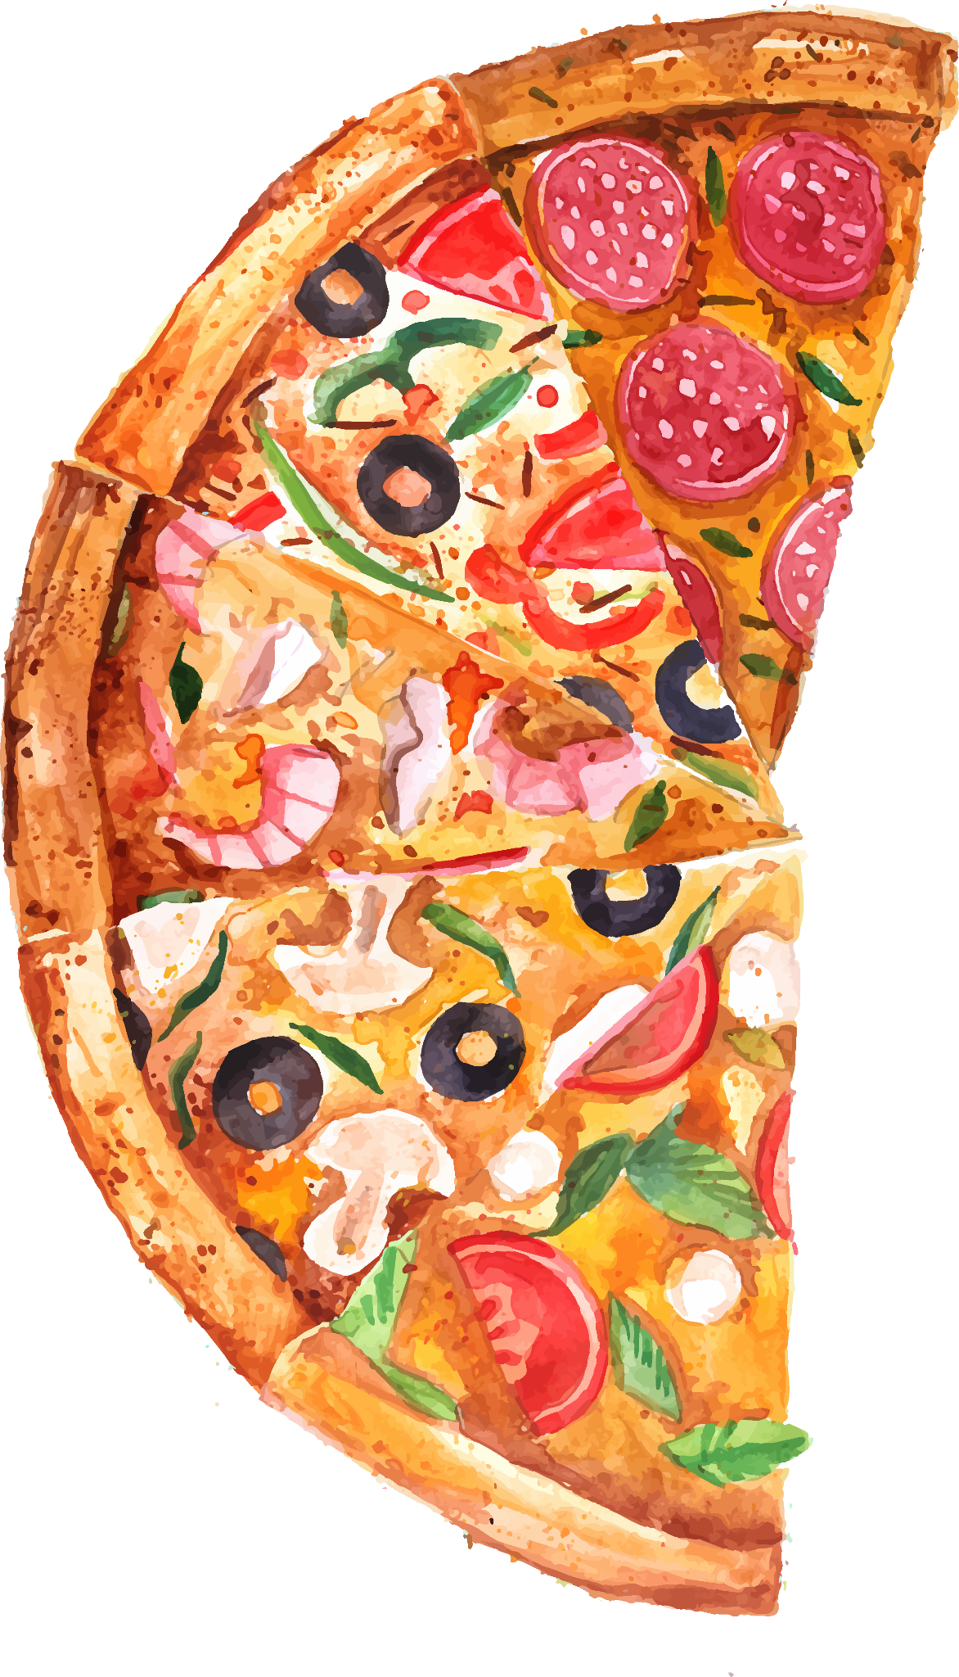
Pizza Sales Analysis

Slide 2
In this project, I have utilized SQL to solve queries that are related to Pizza sales.

Slide 3
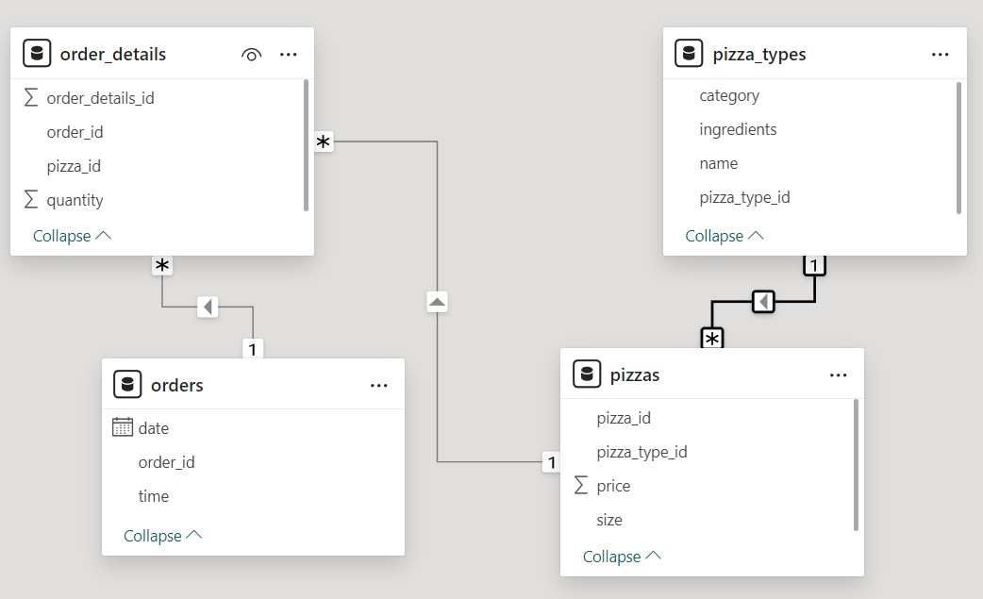

Slide 4
Basic

Slide 5
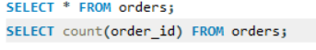
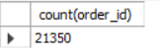
Q1. Retrieve the total number of orders placed.

Slide 6
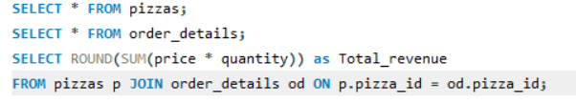
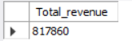
Q2. Calculate the total revenue generated from pizza sales.

Slide 7
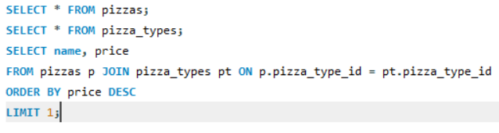
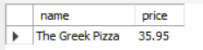
Q3. Identify the highest-priced pizza

Slide 8
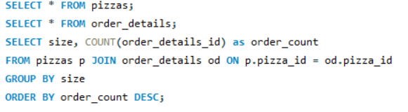
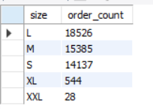
Q4. Identify the most common pizza size ordered.

Slide 9
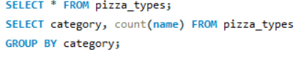
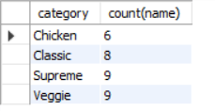
Q5. Find the category-wise distribution of pizzas.

Slide 10
Intermediate

Slide 11
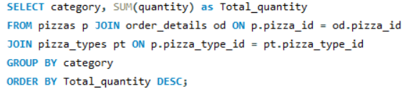
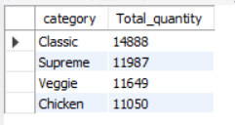
Q6. Join the necessary tables to find the total quantity of each
pizza category ordered.

Slide 12
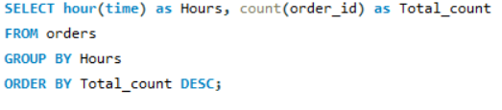
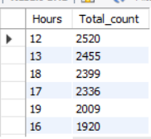
Q7. Determine the distribution of orders by hour of the day.

Slide 13
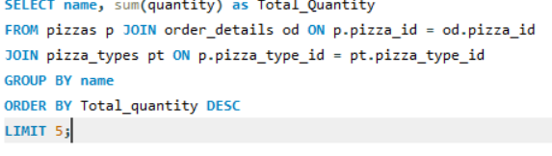
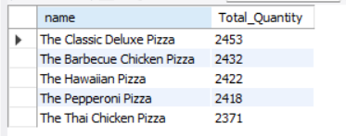
Q8. List the top 5 most ordered pizza types along with their quantities

Slide 14
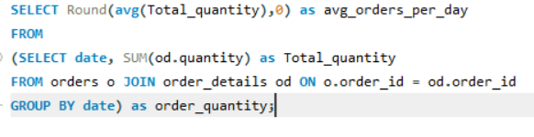
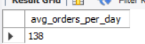
Q9. Group the orders by date and calculate the average number of pizzas ordered per day.

Slide 15
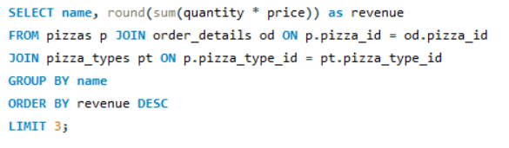
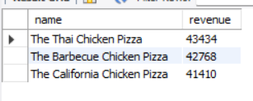
Q10. Determine the top 3 most ordered pizza types based on revenue.

Slide 16
Advance

Slide 17
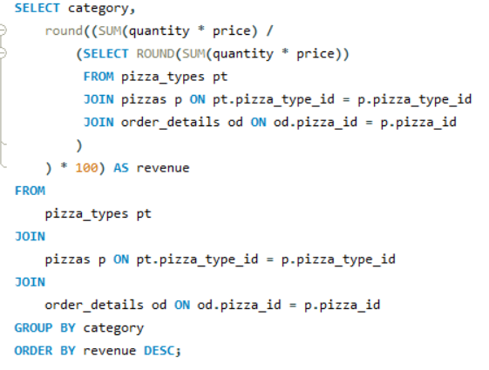
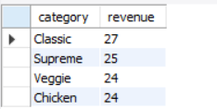
Q11. Calculate the percentage contribution of each pizza type to total revenue.

Slide 18
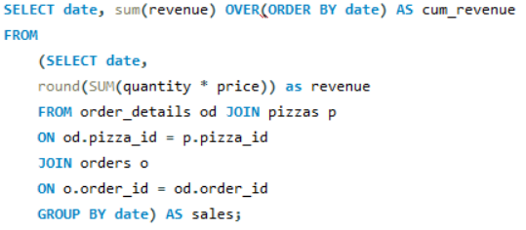
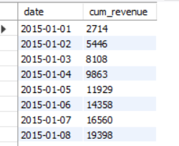
Q12. Analyze the cumulative revenue generated over time.

Slide 19
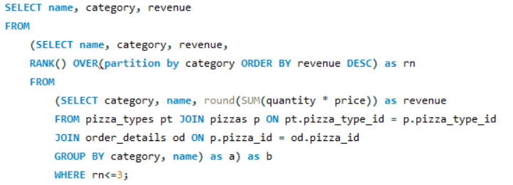
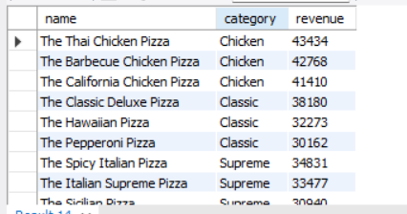
Q13. Determine the top 3 most ordered pizza types based on revenue for each pizza category.

Slide 20
Thank You

